Slide 1


Simple ATM
ATM
Automotive Bootcamp
Vicious Team

Slide 2
Team members:
Abdelrahman.
Moataz.
Mohamed Hassan.
Khaled Mosaad.

Slide 3
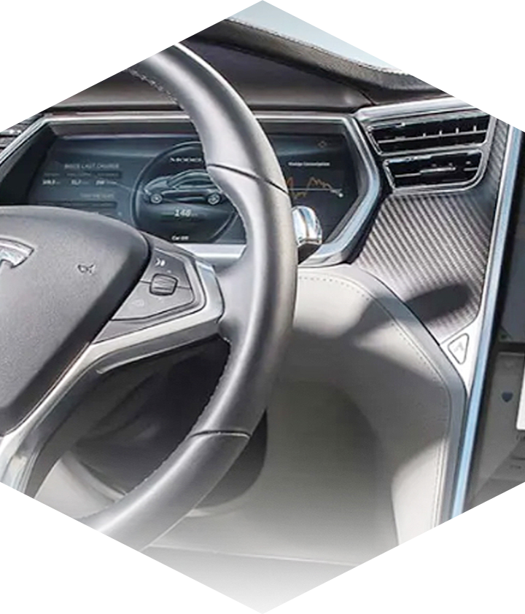
Introduction
Project Layout
Static Design
Content

Slide 4

Introduction
ATM
This is a simple ATM machine

Slide 5
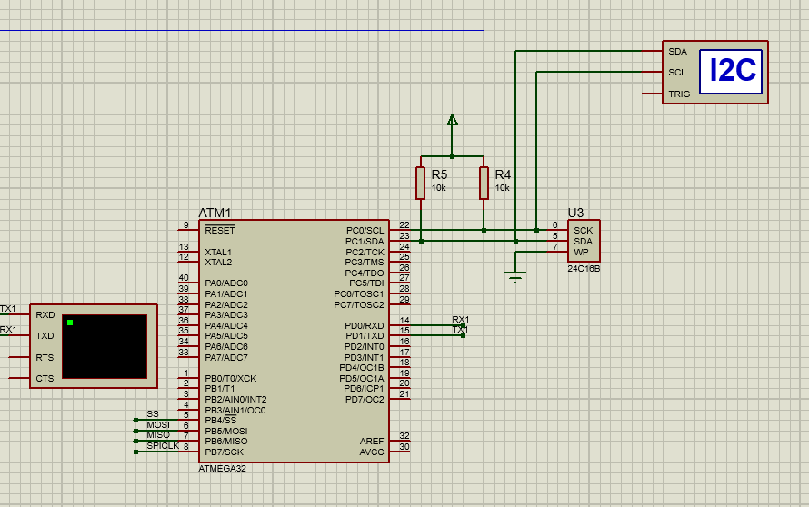
Project Layout
ATM Card

Slide 6
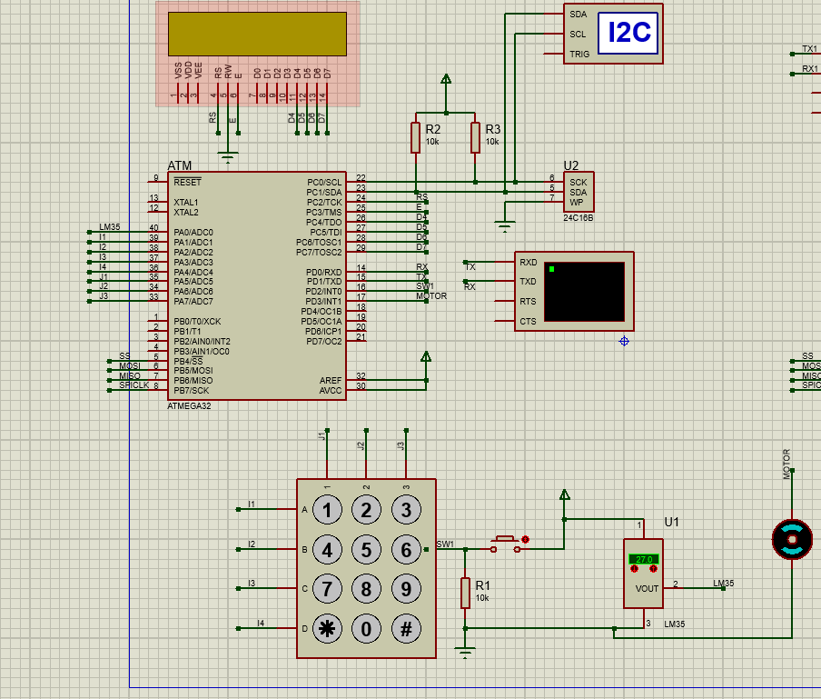
Project Layout cont’d
ATM Terminal

Slide 7

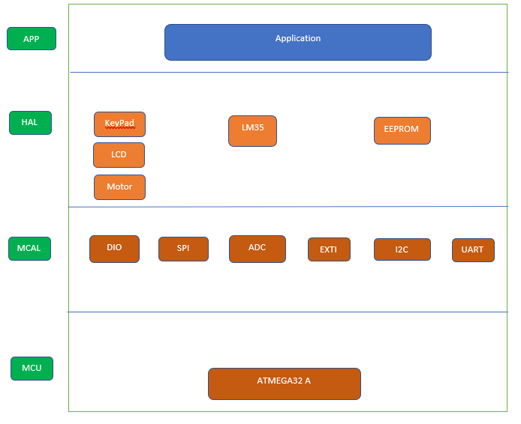
Static Design
ATM Terminal
Layer Architecture

Slide 8
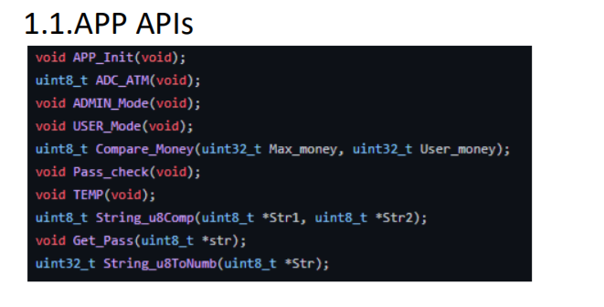
Static Design Cont’d
ATM Terminal

Slide 9
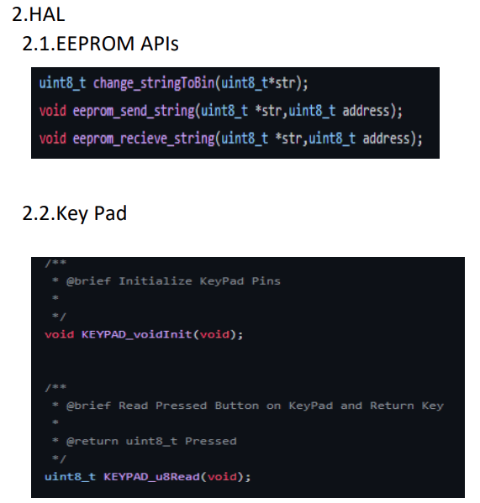
Static Design Cont’d
ATM Terminal

Slide 10
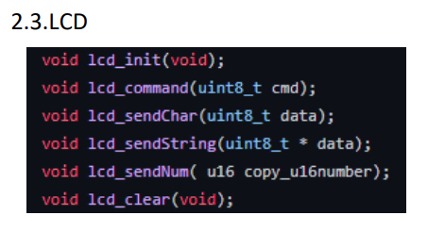
Static Design Cont’d
ATM Terminal

Slide 11
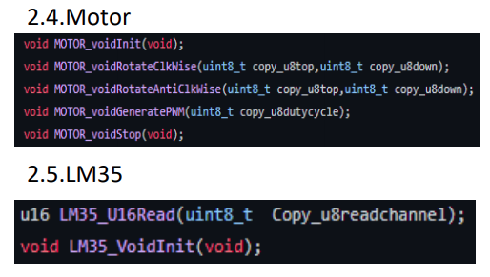
Static Design Cont’d
ATM Terminal

Slide 12
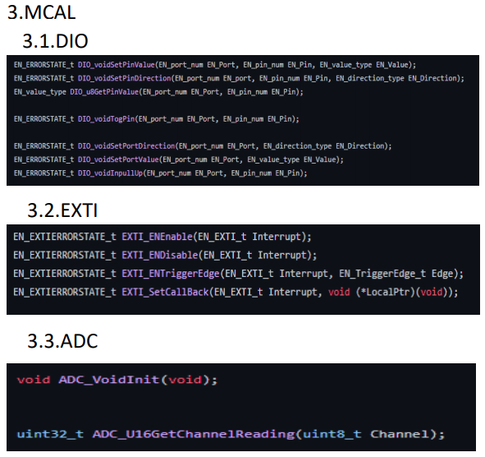
Static Design Cont’d
ATM Terminal

Slide 13
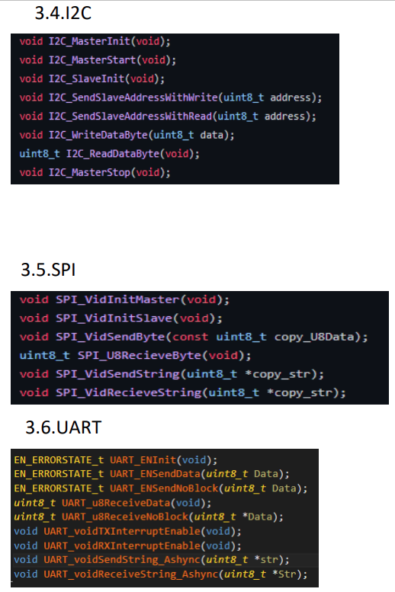
Static Design Cont’d
ATM Terminal

Slide 14
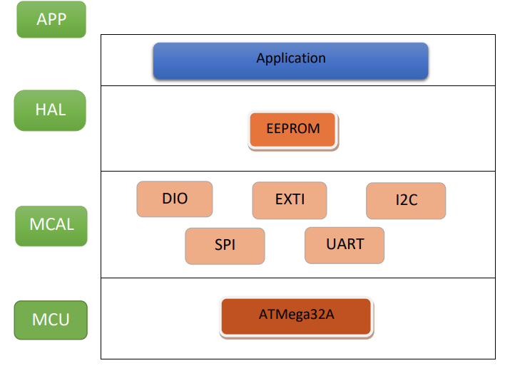
Static Design Cont’d
ATM Card

Slide 15
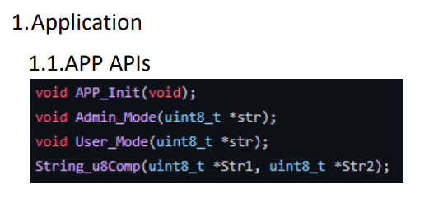
Static Design Cont’d
ATM Card

Slide 16
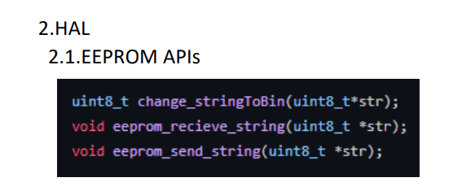
Static Design Cont’d
ATM Card

Slide 17
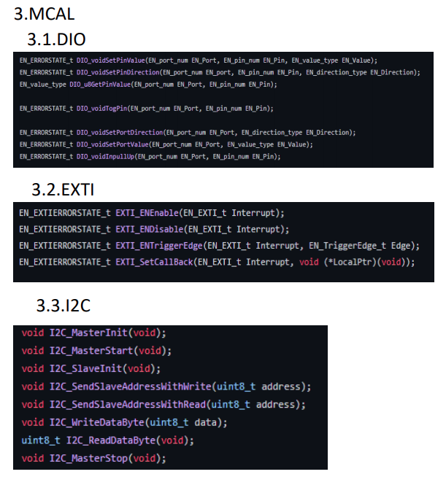
Static Design Cont’d
ATM Card

Slide 18
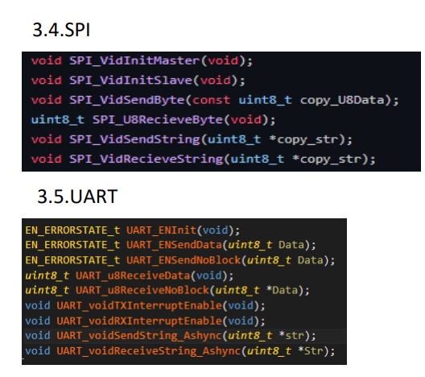
Static Design Cont’d
ATM Card

Slide 19
Test Cases
ATM Card
Test No | Test Case Description | Result
1 | Wrong Entry inserted neither USER nor ADMIN | PASSED
2 | Wrong password inserted in ADMIN mode | PASSED
3 | Wrong Data inserted in ADMIN mode | PASSED
4 | Wrong Data inserted in USER mode | PASSED

Slide 20
Test Cases
ATM Terminal
Test No | Test Case Description | Result
1 | Wrong Entry inserted neither USER nor ADMIN | PASSED
2 | Wrong password inserted in ADMIN mode | PASSED
3 | Wrong Data inserted in ADMIN mode | PASSED
4 | Wrong Data inserted in USER mode | PASSED
5 | Exceeds withdrawal amount limits | PASSED

Slide 21

Thank You.
ATM

